Slide 1
Friends of tracking Liverpool FC challenge
Mikhail Bulygin

Slide 2
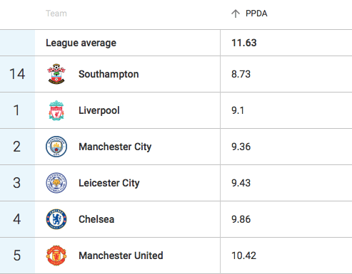
What to look at?
Space
Speed
Correct decisions

Slide 3
What to look at?
Build up:
How many opponent the player cuts with a pass? (efficiency)
How much space does a player gain with a pass? (space)
Which partner does the player pass to? (correct decision)
Finishing:
How fast are the players? (speed)
How much space do they get with a run? (space)

Slide 4
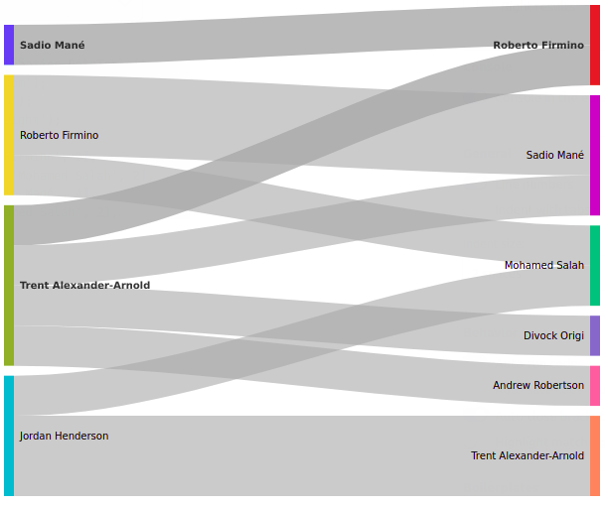
Assist Leaders
Trent Alexander-Arnold – 7 assists/ 10 adv_assists
Top scorers are Sadio Mané and Mohamed Salah – 6 goals
Roberto Firmino – 4 passes to Sadio Mané and 2 passes to Mohamed Salah

Slide 5
Cutting the Cord
The best result for this criteria – Virgil Van Dijk (9 players vs Bayern)
Second best score Naby Keïta – 4.5 players per pass
Excluding < 3 passes:
Jordan Henderson – 4.3 players per pass (6 passes)

Slide 6
Gaining Space
The value is normalized by the amount of space opponent had before the pass
Best result is Naby Keïta vs. Bournemouth (gained 31.8% of opponent’s space)
Second best result
Trent Alexander-Arnold vs. Porto
(gained 31.2% of opponent’s space)

Slide 7
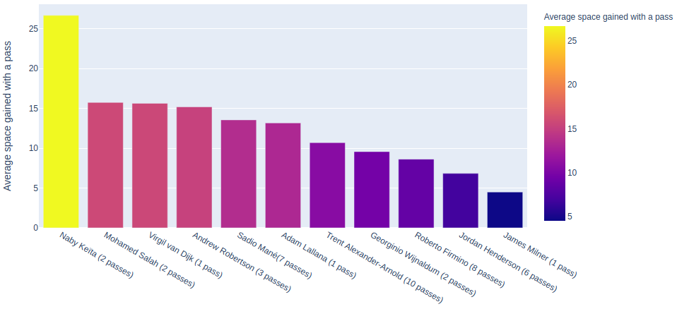
Average Space Gained with a Pass

Slide 8
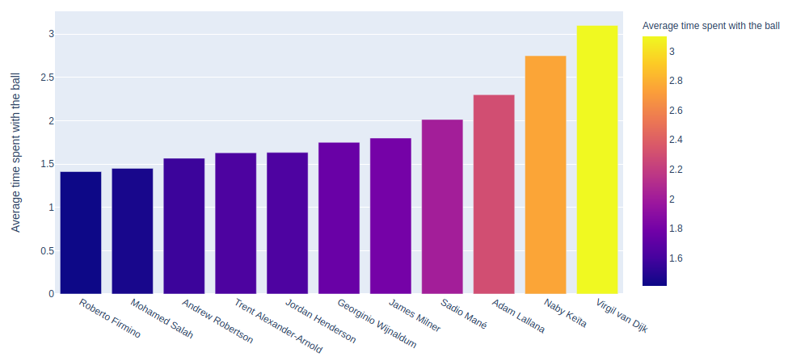
Quick Thinking

Slide 9
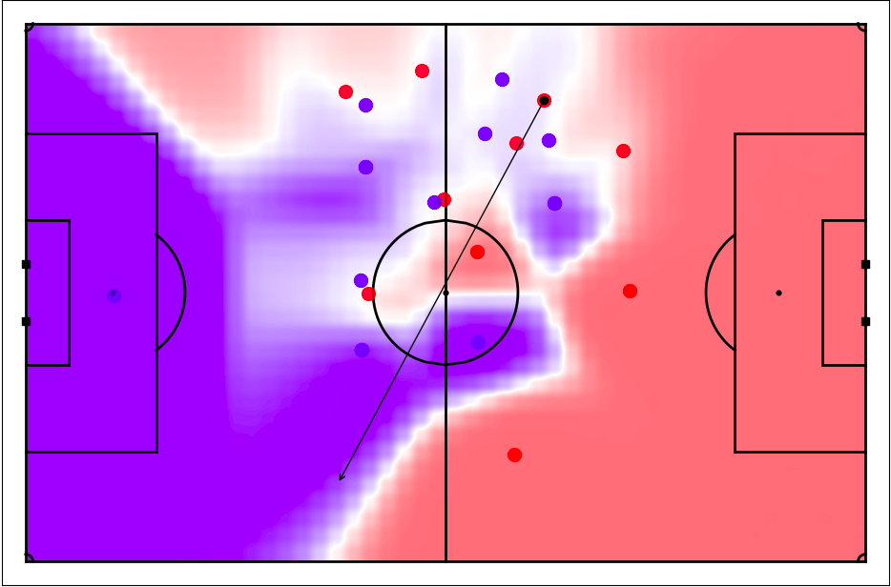
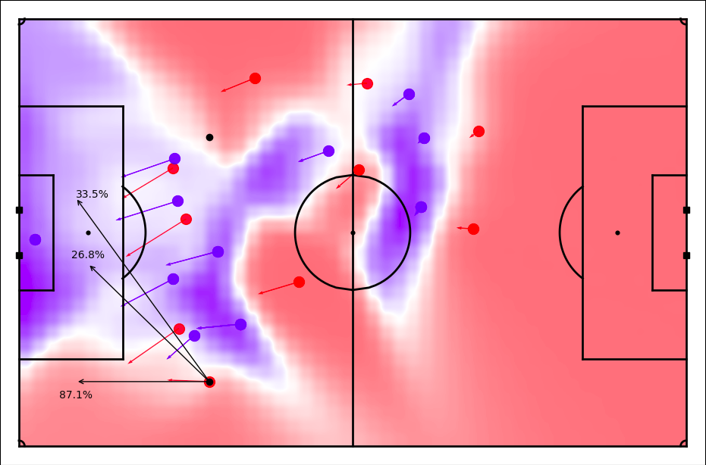
Choosing the Best Option
TTA pass to Andrew Robertson Robertson’s options

Slide 10
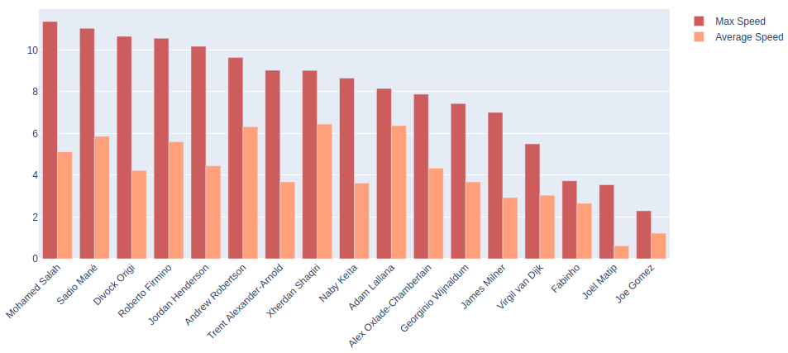
Running Up the Hill

Slide 11
Maximum Speed – Mohamed Salah vs. Watford (11.4 m/s)

Slide 12
Getting to the XGland
Divock Origi vs. Barcelona
Score: 245.71

Slide 13
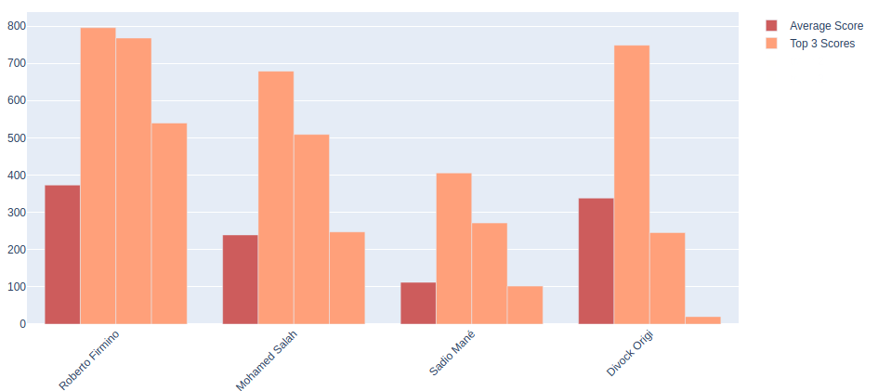
Getting to the XGland

Slide 14
Overview
We performed 7 experiments:
Key findings:
  Jordan Henderson (moving the ball)
  Naby Keïta and Sadio Mané (gaining space)
  Roberto Firmino (quick thinking)
  Mohamed Salah (speed)
  Roberto Firmino (finding space)
Thanks to LastRow and Friends of Tracking!
Link to GitHub is in the description!

